Slide 1


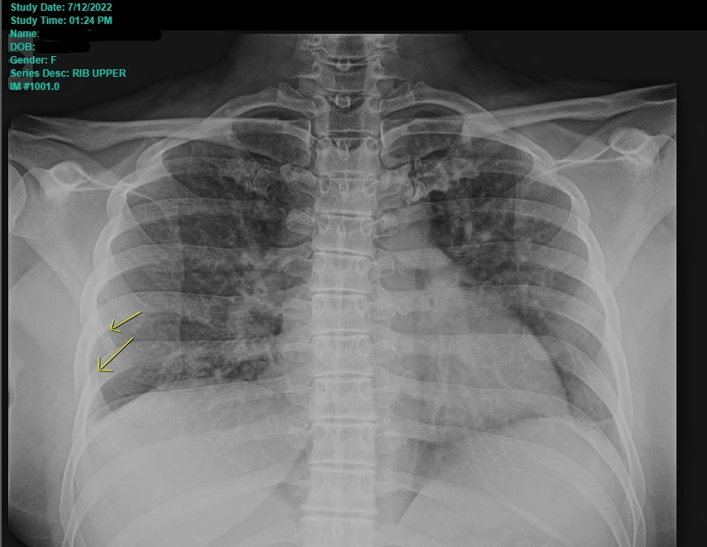
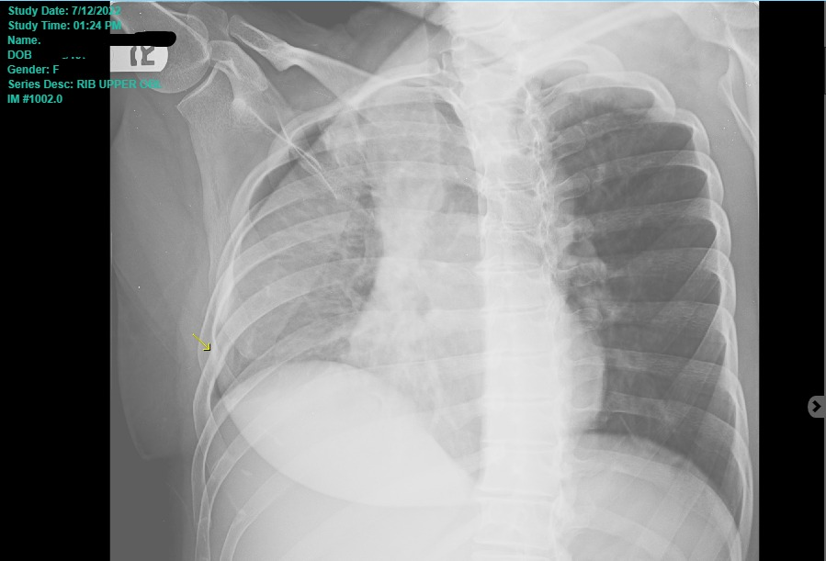
Images
Image 1. Molecular mechanisms of remote lung injury
Chen L, et al. BMC Anesthesiology. 2019; 19:30.
Image 2. Long-term evolution of Acute Respiratory Distress Syndrome
Zompatori M, et al. European Respiratory Review. 2014; 23: 519-530.
Cough-Induced Rib Fractures: A Hidden Diagnostic Challenge
Y. Soto, D. Mustelier, L. Pagán- Pagán, S. Rodríguez, A. Fuentes, and F. Zayas
Department of Family Medicine and Geriatrics, University of Puerto Rico
Introduction
Cough-induced rib fractures, although relatively uncommon, represent a unique and often underreported clinical entity that demands attention and has gained recognition in recent years with an increasing number of documented cases in the literature. Primarily, coughing is regarded as a protective reflex; however, in certain instances, it can evolve into a causative factor for rib fractures, leading to a spectrum of clinical presentations ranging from subtle discomfort to debilitating pain. Our aim is to shed light on the intricate interplay between forceful coughing and rib fractures, exploring the underlying diagnostic challenges and implications for patient care.
Case Description
Patient History
A 44 year-old female with a medical history of moderate to severe persistent Bronchial Asthma and Sinusitis presented to the ED due to difficulty breathing, shortness of breath, chest tightness, breathlessness, and abundant sputum production that started seven days prior. The patient referred a recent admission to a hospital in the periphery due asthma exacerbation and reported three hospitalizations in the past three months due to similar complaints. At home, she uses leukotriene receptor antagonist, inhaled corticosteroid, long-acting beta agonist, and immunomodulation therapy. Over the past seven days, she had experienced increased respiratory difficulty that did not respond to home respiratory therapies, prompting her ED visit. Upon admission, she denied fever, chills, recent travel, ill contacts, chest pain, palpitations, anxiety, dyspnea on exertion, pleurisy, hemoptysis. Her family history included hypertension and asthma. Patient denied tobacco or any other type of inhalant use.
Physical Exam
On initial evaluation, the patient was noted with persistent cough and in acute respiratory distress due to use of accessory muscles. Vital signs were notable for tachypnea, tachycardia, hypertension and pulse oximetry reading of 98%. Physical exam revealed decreased breath sounds, chest was non-tender to palpation, and diffuse bilateral wheezing. Laboratory workup was remarkable for leukocytosis with predominance of eosinophils, monocytes, and neutrophils. The chest x-ray revealed bilateral peribronchial thickening with lower lobe interstitial opacities and questionable pleural effusions, and osseous structures showed no acute abnormality. Subsequently, a chest CT was ordered, and the report indicated patchy opacities at the lung bases. Therefore, infectious etiology could not be excluded.
Clinical Course
The patient was admitted with a diagnosis of asthma exacerbation and a rule-out of hospital acquired pneumonia in the setting of a recent emergency evaluation at another institution. During the hospitalization, the patient required respiratory support with non-invasive positive pressure ventilation. The patient underwent an intensive regimen of respiratory nebulizations every hour and received intravenous steroids as well as intravenous magnesium. Since admission, the patient remained with a persistent bothersome cough managed with antitussive medications. However, on day #2 of admission, the patient developed exquisite pain in the right coastal area. Initially addressed conservatively, considering chest wall pain was expected during the acute phase of status asthmaticus. Despite adequate treatment response, the patient continued to persist with pain. On day #5 of admission, a chest x-ray was ordered and showed no acute cardiopulmonary process, and the bony thorax unremarkable. On admission day #7, upon palpation at the right coastal area the patient had exquisite tenderness, 10/10 intensity. Three view rib x-rays were subsequently ordered, indicating a nondisplaced fracture of the right lateral fifth rib and minimally displaced fracture of the right lateral sixth rib.
Discussion
Cough is a symptom that is often non-concerning, as it is expected in patients with respiratory tract infections. It serves as the body’s mechanism to clear respiratory secretions and foreign substances from the respiratory tree. Generally treated supportively, cough is not a symptom we typically intend to suppress. However, cough-induced rib fractures, though managed supportively, can lead to severe complications if physicians are unaware of the diagnosis. Cough-induced rib fractures of the lower ribs may result in rupture of the diaphragm and subsequent abdominal complications, such as abdominal wall herniation [1]. Furthermore, there have been reported cases in the literature documenting other complications such as subcutaneous emphysema and pneumothorax [6]. Vascular damage following a cough-induced rib fracture may lead to hemothorax, causing lung collapse and subsequent organ damage [2]. Like our patient, a study showed that the most common cough-induced rib fracture location was the 6th rib, precisely in the lateral aspect of the rib cage [4]. Although our patient was successfully treated supportively and recovered well, a literature review emphasized the importance of considering this diagnosis when experiencing acute chest or coastal pain after severe cough to avoid complications. Most cases reported in the literature involved patients with chronic respiratory medical conditions and prolonged exposure to steroids, indicating that risk factors may be associated with decreased bone density, such as smoking and steroid use. Finally, our patient was discharged with a medical order to undergo bone densitometry and instructed to follow up with a primary care physician.
Conclusion
▸Cough-induced rib fractures, although rare, may occur in patients with chronic respiratory conditions (eg, Asthma, COPD), advanced age and osteoporosis, as well as in post-menopausal women, and those with a prior history of rib fractures.
▸The subtlety of symptoms should trigger a comprehensive evaluation, including an extensive description of presenting symptomatology, to avoid misdiagnosis and ensure timely intervention through diagnostic imaging and adequate management.
This is crucial for preventing complications such as ruptured diaphragm, abdominal herniation, and pneumothorax. Supportive treatment is recommended, and consideration should be given to evaluating underlying etiologies, as warranted, with a primary care physician.
References
1. Bezerra LS, Barbosa da Silva GS, Santos-Veloso MAO, Bosford MAP, Marinho Ribeiro Carvalho AR. Clinical and Radiological Aspects of Cough-induced Rib Fractures: A Case Report. Cureus. 2020 Feb 1;12(2):e6840. doi: 10.7759/cureus.6840. PMID: 32175207; PMCID: PMC7051105.
2. Camarillo-Reyes LA, Marquez-Córdova RI, Surani S, Varon J. Hemothorax induced by severe cough: An unusual presentation. SAGE Open Med Case Rep. 2019 Apr 26;7:2050313X19846043. doi: 10.1177/2050313X19846043. PMID: 31065358; PMCID: PMC6487754.
3. Daniel R, Naidu B, Khalil-Marzouk J. Cough-induced rib fracture and diaphragmatic rupture resulting in simultaneous abdominal visceral herniation into the left hemithorax and subcutaneously. Eur J Cardiothorac Surg. 2008 Oct;34(4):914-5. doi: 10.1016/j.ejcts.2008.06.048. Epub 2008 Aug 19. PMID: 18715797.
4. Hanak V, Hartman TE, Ryu JH. Cough-induced rib fractures. Mayo Clin Proc. 2005 Jul;80(7):879-82. doi: 10.4065/80.7.879. PMID: 16007893.
5. Hillenbrand A, Henne-Bruns D, Wurl P. Cough induced rib fracture, rupture of the diaphragm and abdominal herniation. World J Emerg Surg. 2006 Nov 24;1:34. doi: 10.1186/1749-7922-1-34. PMID: 17125506; PMCID: PMC1675993.
6. Shukri WNA, Ng VH, Ismail AK. A case of cough induced rib fracture with subcutaneous emphysema and pneumothorax. Med J Malaysia. 2019 Dec;74(6):551-552. PMID: 31929488
Figure 1: Chest X-Ray at admission
Figure 2: Rib X-Ray

