Slide 1


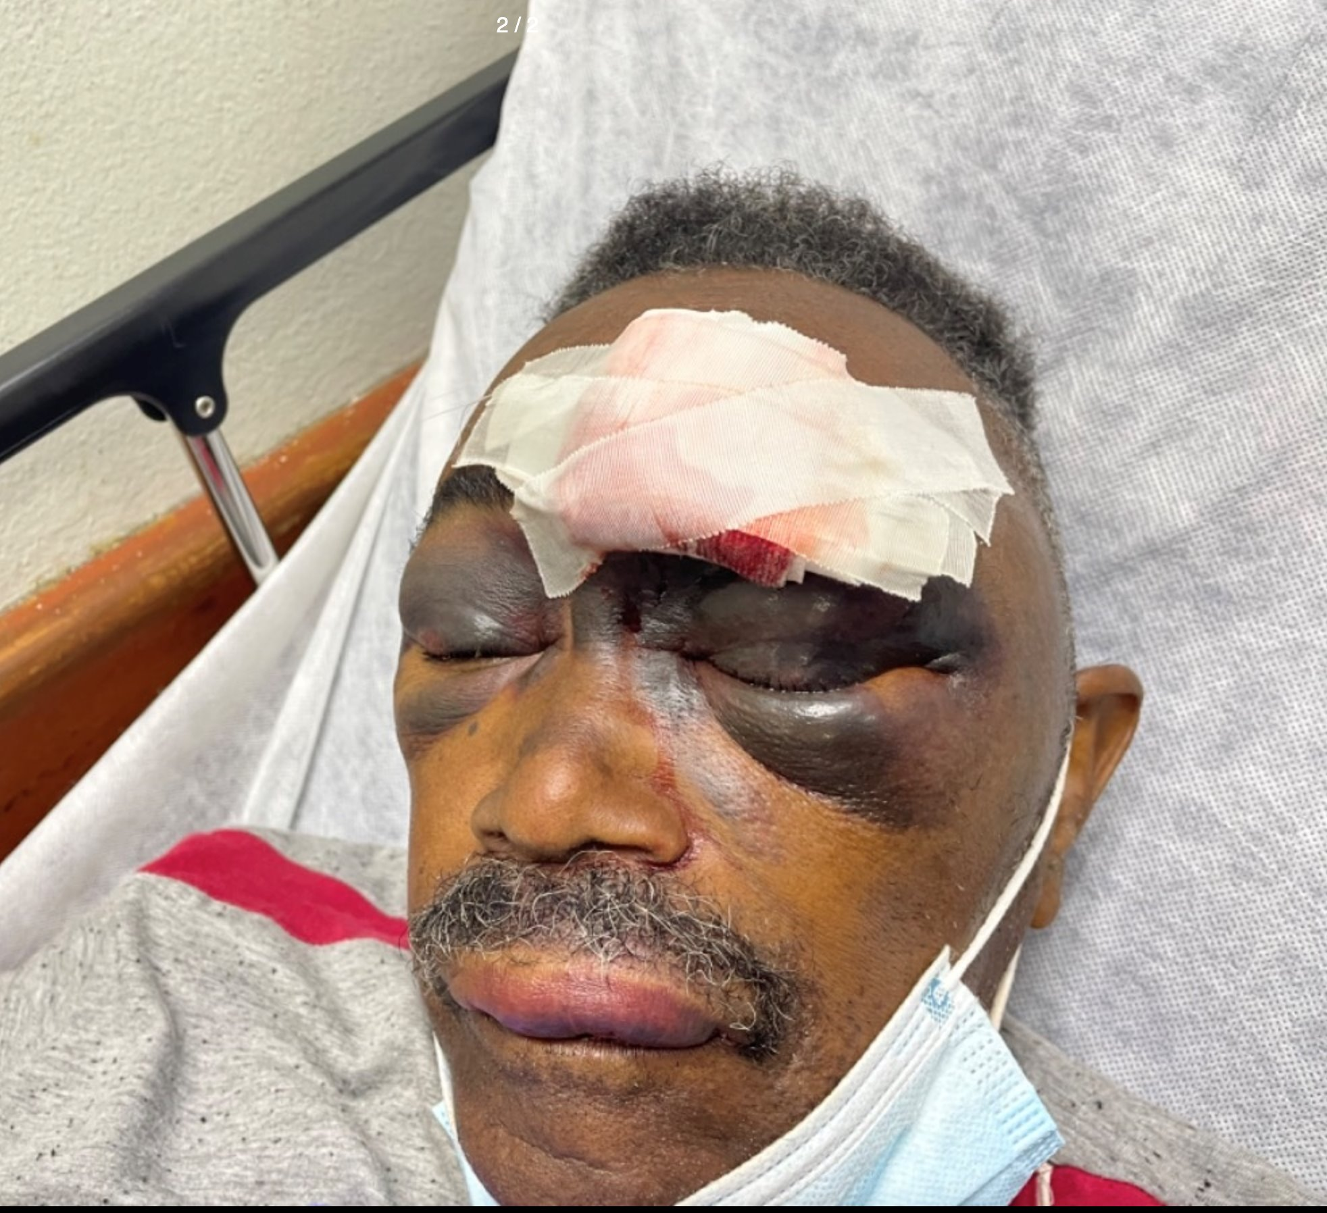
“Beyond Platelets: Exploring the Impact of Social Determinants on Thrombocytopenia workup - A Case Report"
Sanchez, K., Marcano, M., Pagan, L., Carnet, Y., Rodríguez, S., and Rivera, A.
Department of Family Medicine and Geriatrics, University of Puerto Rico School of Medicine
Abstract
Patient History
Clinical Course
Discussion
Family physicians often see patients who present with a low platelet count. Although further inquiry may elicit additional signs and symptoms of systemic disease, the etiology of thrombocytopenia usually is not immediately apparent. This is the case of a 77-year-old male with a past medical history of hypertension, who presented to the emergency room due to a large facial hematoma after a fall with minimal head trauma and was found incidentally with anemia and severe thrombocytopenia, later diagnosed with leukemia. Patients with severe thrombocytopenia typically present with symptoms that range from petechiae to major systemic bleeding. However, this was not the typical presentation in our case. This case presentation is an overview of a clinical approach to thrombocytopenia with emphasis on clinical diagnosis, management, and impact of social determinants of health. Our aim with this case report is to bring to light some of the challenges that social inequity and poor access to healthcare in Loiza has led to delayed diagnosis and inadequate preventive care.
Admission diagnosis: Severe thrombocytopenia and symptomatic anemia.
Treatment: Blood transfusions with PRBCs and platelets and was placed on hematinic support therapy with Vitamin B12 and Folate.
In-hospital evaluations and consultations: An upper abdominal ultrasound done without pathological findings. Ophthalmology consult found a stable conjunctival hemorrhage and schedule OPD follow up. Hematology Oncology consultation agreed with a suspected malignant bone marrow disorder that would require a bone marrow biopsy with molecular profiling and cytogenetics in the OPD setting.
Follow up: Several admissions due to persistent thrombocytopenia.
Thrombocytopenia is associated with a wide range of clinical presentations, from mild symptoms up to life-threatening conditions. A commonly observed bicytopenia is anemia with thrombocytopenia. Etiologies may range from transient suppression up to malignancies, nutritional deficiencies to inflammatory diseases. Upon encountering bicytopenia, careful consideration should be done to evaluate malignancy potential specially when persistent monocytosis is also present. The evaluation of malignancy in patients presenting with severe thrombocytopenia (<50K) and other concerning clinical findings, is paramount. Early detection with thorough evaluation allows for timely intervention and initiation of appropriate therapies.
The diagnosis of this patient was delayed due to many social determinants including limited access to services (lack of resources to do an adequate hematological evaluation in our hospital and neighbor hospital covered by patient’s medical insurance did not have available beds for transfer), lack of transportation (limited routine visits to PCP and further visits to OPD oncologist), and patient’s poor health literacy (affecting the patient’s capacity to obtain, process, and understand basic health information and services needed to make appropriate health decisions). All these constraints profoundly influenced the patient's timely diagnosis and treatment, introducing significant barriers that delayed definitive care, exacerbating health disparities and leading to poorer outcomes for individuals. Comprehensive approaches that address social determinants are crucial for equitable access to healthcare.
A 77-year-old male with history of hypertension and no recent evaluation by primary care physician. Evaluated at emergency room after an unwitnessed fall and face trauma at home after suffering syncopal episode. Patient referred dizziness, poor appetite and weight loss over the last couple of months. Denied evidence of bleeding or skin rashes or toxic habits. ER labs showed low hemoglobin and low platelets. Case was consulted for further management of bicytopenia.
2nd Adm. | Patient clinically stable despite thrombocytopenia. Required transfusion for 3 units of apheresis.
3rd Adm. | Patient with severe thrombocytopenia and new onset monocytosis, presenting with fatigue, palatal petechia, episodic hematochezia, and right flank hematoma. Abdominopelvic CT found a subcutaneous hematoma. Patient received a 5 PRBC units and 5 apheresis units.
4Th Adm. | Patient admitted for inpatient bone marrow biopsy. On arrival, he was found with a pericardial effusion. Subsequent clinical deterioration required mechanical intubation.
References
Summary of Findings
Bezerra LS, Barbosa da Silva GS, et al.. Clinical and Radiological Aspects of Cough-induced Rib Fractures: A Case Report. Cureus. 2020 Feb 1;12(2):e6840. doi: 10.7759/cureus.6840. PMID: 32175207; PMCID: PMC7051105.
Mank V, Azhar W, Brown K. Leukocytosis. [Updated 2024 Feb 4]. In: StatPearls [Internet]. Treasure Island (FL): StatPearls Publishing; 2024 Jan-. Available from: https://www.ncbi.nlm.nih.gov/books/NBK560882/
Mental status | No acute distress, GCS 15
Physical exam | Facial swelling, left eyebrow laceration with sutures in place with oozing blood, bilateral periorbital hematoma and edema, and pale oral mucosa with aphthous ulcer at left inner cheek
Laboratory results | Macrocytic anemia (Hgb 7.3) and severe thrombocytopenia (9,000 plts.)
Head CT | Large hematomas in bilateral frontal scalp and left periorbital region.
Maxillo-facial CT | Large hematomas in bilateral frontal scalp and left periorbital region.
Bone marrow biopsy results were compatible with acute myeloblastic leukemia.
Conclusions
There is no doubt that social inequity contributes to health disparities significantly impacting underserved communities, such as Loiza, P.R. This in fact contributes to an increase in morbidity and mortality lowering life expectancy. It is crucial that as family physicians we advocate for equitable access to healthcare to ensure our patient's wellbeing.
Acknowledgements
Endowed Health Services Research Center. Awards 5S21MD000242, 5S21MD000138 from NIH-NCMHD

