Slide 1


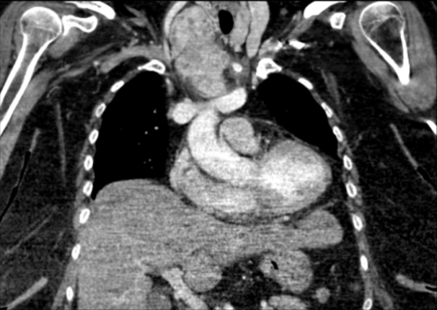
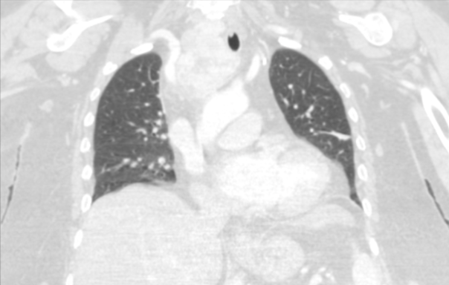
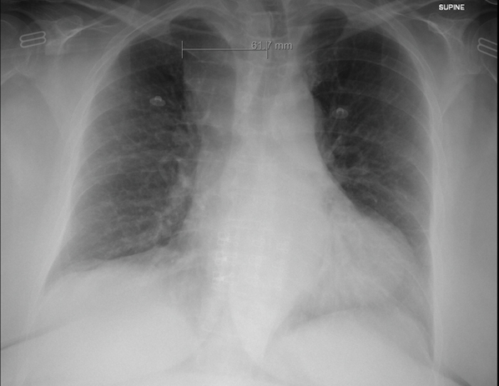
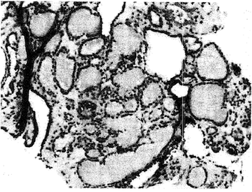
An unexpected presentation of a multinodular goiter, a case report.
André Medina, PGY-1¹; María De Los Ángeles De Jesús, LCP. PhD²; Aracelis Nieves, MD³
Manatí Medical Center: ¹ Family Medicine Residency Program, PGY-1; ² Department of Family Medicine/Behavioral Science; ³ Department of Family Medicine.
Contact email: amedina2011@gmail.com
Manatí Medical Center, Manatí, PR
Introduction
Hospital Course
Discussion
The mediastinum is vulnerable to developing a wide variety of benign and neoplastic masses¹.
Most primary mediastinal tumors develop in the anterior mediastinum, which can cause phrenic nerve palsy or superior vena cava syndrome¹.
In 59% of instances, anterior mediastinal masses are malignant, whereas the proportions for middle and posterior masses are 29% and 16%, respectively¹.
Owing to the complex anatomical aspects of the mediastinum, these conditions not only give rise to difficulties in diagnosis and treatment, but also carry a substantial mortality risk².
Effective evaluation, diagnosis, and collaboration between the interdisciplinary team are critical in order to prevent Mediastinal Mass Syndrome (MMS), which is caused by mechanical compression of mediastinal structures and results in acute respiratory and hemodynamic decompensation².
Biopsychosocial:
Patient with professional background and graduate degree, main caretaker of her father and disabled son.
GAD-7: 2
AUDIT: 0
PHQ-9: 4
DAST-10: 0
Diagnosis and Intervention:
Biopsy of the mass revealed ectopic thyroid tissue, without evidence for malignancy.
Outcome:
Subsequent complete surgical resection of mediastinal mass was successful via open chest surgery by thoracic and ENT surgeons.
Pathology confirmed the presence of benign ectopic thyroid tissue.
Resolution of symptoms postoperatively was achieved and continued to be monitored for any recurrence or complications.
Invasion of the anterior mediastinum by multinodular goiter is a rare manifestation, presenting unique diagnostic and management challenges.
Despite initial concern for malignancy, subsequent biopsy revealed benign ectopic thyroid tissue.
Small findings should not be insignificant when reviewing images that can provide answer to unexplained signs and symptoms.
This case highlights the importance of interdisciplinary collaboration in managing uncommon manifestations of common diseases.
Learning Points
Complications can arise even in the absence of overt symptoms, serving as a reminder for clinicians to explore atypical presentations, and propose potential avenues for future research, enabling a more nuanced understanding of the potential complexities associated with multinodular goiters.
Fig. 2. A chest CT with IV contrast confirmed a 7.3 x 6.4 x 5.5 cm right paratracheal mass described as highly suspicious for malignancy.
Clinical Case
A 68-year-old woman with a medical history of hypertension, dyslipidemia, diabetes mellitus, obesity class III, and hypothyroidism, presented with elevated blood pressure, constant retrosternal chest pain, nausea, dizziness, and confusion of two days evolution.
Initial evaluation including cardiac enzymes and thyroid-stimulating hormone (TSH) showed no abnormalities.
References
Li, W. W., Van Boven, W. J. P., Annema, J. T., Eberl, S., Klomp, H. M., & De Mol, B. A. (2016, March 1). Management of large mediastinal masses: surgical and anesthesiological considerations. Journal of Thoracic Disease. https://doi.org/10.21037/jtd.2016.02.55
Kim, J. Y., & Hofstetter, W. L. (2010, October). Tumors of the Mediastinum and Chest Wall. Surgical Clinics of North America, 90(5), 1019–1040. https://doi.org/10.1016/j.suc.2010.06.005
Approved by the PHSU IRB Protocol number 2401180023
Fig. 1 A careful review of chest radiograph revealed an enlarged extrinsic mediastinal mass with right-sided deviation, correlating with the patient's symptoms (AP Chest X-ray: 61.3 mm mediastinal mass identified).
Fig 3. Immunohistochemistry (IHC) stains for TTF-1, p53, and Ki-67 were performed. A. Upper mediastinal mass: TTF-1 stain is positive, ectopic thyroid tissue present. p53 and K1-67 stains show no increased activity.
B. FNA and histology: Fourteen smeared slides examined. Mainly blood components are present. No malignant cells found.
Contact email: maricv7@gmail.com

