Slide 1

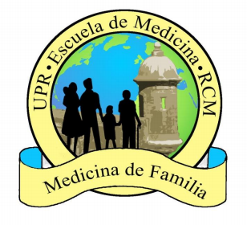
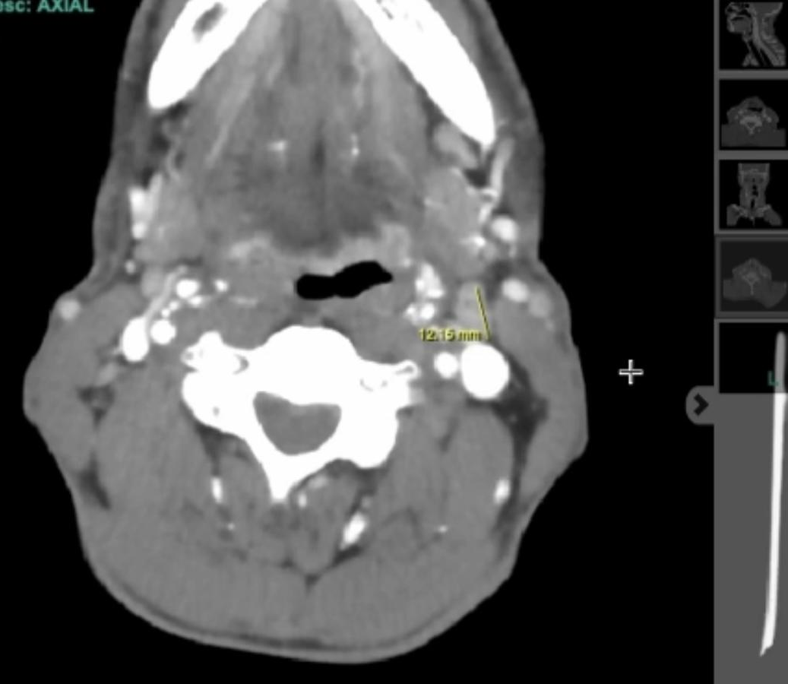
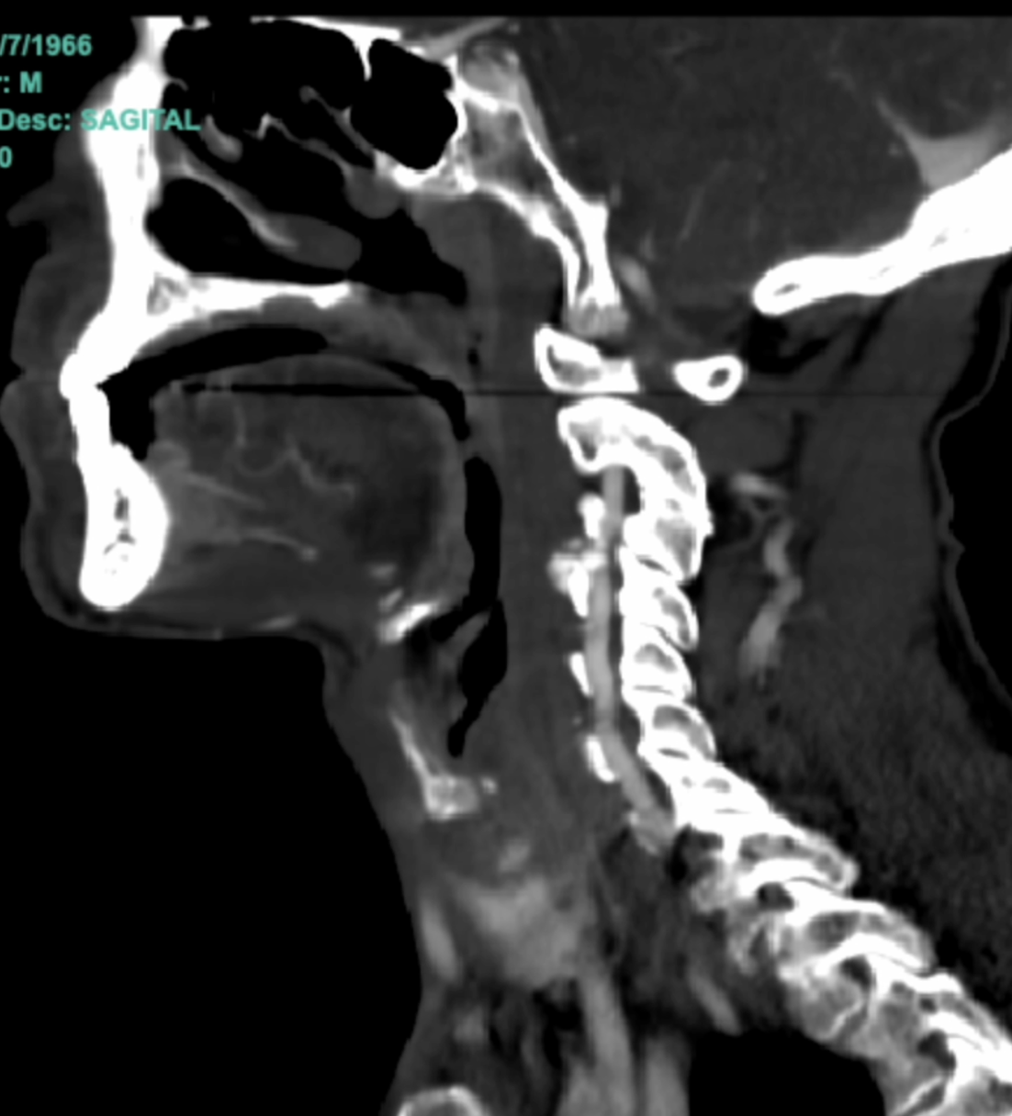
A Case of Asymmetrical Weakness and Life-Threatening Bulbar Dysfunction: What not to miss?
D. Figueroa M.D., S. Rodríguez M.D., A. Ruiz M.D., A. Fuentes M.D., P. Henríquez M.D.
Department of Family Medicine and Geriatrics, University of Puerto Rico
Introduction
Case Description
Discussion
Patient History
A 57-year-old male patient with past medical history of Thyroid carcinoma status post chemotherapy and radiotherapy, Bronchial asthma, Discogenic disease, and Neuropathy presented to the emergency department due to dysphagia and lower extremity weakness (left > right) since the night prior to evaluation. The patient reported symptoms initially began with an intractable headache in the occipital region for which the patient took acetaminophen with no improvement of symptoms. Eventually, the patient developed subjective fever, numbness of bilateral cheeks, sore throat, difficulty swallowing associated with shortness of breath, and lower extremity weakness, which prompted ED visit. The patient denied recent illness, nausea, vomiting, chest pain, palpitations, diarrhea, runny nose, cough, abdominal pain, rashes, or dizziness. He admitted to eating canned food weekly and denied recent bites, stings, or contact with contaminated water. The case was consulted to the Family Medicine service for further evaluation and management.
Summary of Findings
Clinical Course
The patient was admitted, and due to clinical deterioration and severe sialorrhea, dysphagia, and ascending paralysis with areflexia, the decision was made to secure the airway intraoperatively and transfer the patient to the ICU for further evaluation and management while continuing IV steroids and respiratory support. After initial stabilization, further studies were conducted, including a lumbar puncture revealing an albuminocytologic dissociation, a classical pathognomonic finding in Guillain-Barré syndrome. Furthermore, other results revealed a positive COVID-19 antigen assay and reactive Mononucleosis antibody. Broad differential and confounding clues in history were present throughout, including the patient’s history of eating canned foods weekly, nonspecific upper respiratory symptoms, positive COVID-19 and Mononucleosis assay, tonsillitis/pharyngitis on neck CT. Despite the wide range of possible diagnoses, the medical team gave the highest priority to GBS because of the patient's sudden and severe symptoms. The team consulted with the neurology service, who agreed that the patient had an unusual form of GBS affecting the nerves in the face and throat. Treatment began with intravenous immunoglobulins, which led to a significant improvement in the patient's condition. By the third day of treatment, the patient had regained strength in all limbs and decreased sialorrhea, leading to eventual weaning off and extubation of mechanical ventilation. After making a remarkable recovery and returning to their normal state, the patient was discharged on the twelfth day of their hospital stay.
Guillain-Barre syndrome (GBS) is an autoimmune disorder characterized by acute onset symmetric weakness and areflexia, often following an infectious illness. While its typical presentation involves ascending paralysis, atypical bulbar involvement, such as cranial nerve palsies, can occur, leading to diverse clinical manifestations and diagnostic challenges. GBS affects individuals of all ages, with a slight male predominance and its annual incidence varies globally, ranging from 0.6 to 4 cases per 100,000 population. Common triggers include respiratory or gastrointestinal infections, vaccination, surgery, or other immunological stimuli. Approximately 30% of GBS cases present with atypical features, including bulbar involvement. These atypical presentations pose diagnostic challenges and may require additional investigations, such as nerve conduction studies and cerebrospinal fluid analysis, to confirm the diagnosis and guide appropriate management strategies. This poster aims to meticulously analyze a clinical case of an atypical GBS presentation diagnosed in our family medicine ward. By scrutinizing deviations from the classical GBS phenotype, we aim to deepen clinicians' understanding of nuanced manifestations, facilitating expedited recognition and tailored interventions for optimal patient outcomes. Delving into these atypical presentations draws attention to the heterogeneous nature of GBS, urging family medicine physicians to remain vigilant for subtle variations that can significantly impact the diagnosis, management, and prognosis of patients diagnosed with GBS.
The presented case underscores the clinical challenges in diagnosing atypical bulbar Guillain-Barre syndrome (GBS), a condition characterized by acute symmetric weakness and areflexia, often following an infectious illness. Despite its typical ascending paralysis, GBS can manifest with diverse clinical presentations, including cranial nerve involvement, posing diagnostic complexities. In this case, the patient's initial symptoms of dysphagia and lower extremity weakness, coupled with bulbar findings on physical examination, prompted a comprehensive evaluation to ascertain the underlying etiology. Notably, the patient's medical history, including thyroid carcinoma s/p chemotherapy and radiotherapy, bronchial asthma, and neuropathy, added layers of complexity to the diagnostic process. The differential diagnosis was broadened by confounding clues such as the patient's recent COVID-19 vaccination, positive COVID-19 antigen assay, and reactive mononucleosis antibody, highlighting the importance of considering multiple etiologies in the context of acute neurological deterioration. Furthermore, imaging studies revealed findings suggestive of acute tonsillitis and pharyngitis, contributing to the diagnostic challenge. However, the presence of albuminocytologic dissociation on lumbar puncture, a classical hallmark of GBS, solidified the diagnosis despite the myriad of differential possibilities. Management of atypical bulbar GBS necessitated prompt recognition and intervention to prevent respiratory compromise and ensure optimal outcomes. Following emergent stabilization and initiation of Gammagard therapy, the patient demonstrated remarkable clinical improvement, highlighting the efficacy of early intervention in mitigating disease progression. This case highlights the significance of a multidisciplinary approach involving family medicine, emergency medicine, neurology, and critical care teams in managing complex neurological conditions such as atypical bulbar GBS. Thorough history-taking, meticulous physical examination, and judicious use of diagnostic modalities are critical in guiding tailored therapeutic interventions. By elucidating the diagnostic and management challenges encountered in this case, we aim to deepen clinicians' understanding of the heterogeneous nature of GBS and underscore the imperative of maintaining a high index of suspicion for atypical presentations to optimize patient outcomes.
Physical exam | Anxious, in distress, tripod position, sialorrhea, erythematous, white plaques in the oropharynx, asymmetric tonsillar swelling R>L, uvular deviation, upward gaze limitation, LUE 0/5, RUE 5/5, LLE/RLE 1/5. Absent DTRs b/l lower extremities, left biceps 1+.
Laboratory results | + COVID-19 antigen assay and Mononucleosis Ab LP: albuminocytologic dissociation in CSF
Neck CT | acute tonsillitis and pharyngitis causing moderate oropharyngeal airway narrowing
References
Conclusions
Matayeva, Elyana, et al. A 48-Year-Old Man with Excessive Drooling and Descending Paralysis Requiring Mechanical Ventilation. Chest, vol. 156, no. 1, July 2019, pp. e9–e13, https://doi.org/10.1016/j.chest.2019.01.026.
Madu, Alpha, et al. A Missed Diagnosis of Guillain-Barre Syndrome Masquerading as Stroke in an Acute Medical Unit: A Case Report. Case Reports in Clinical Practice, vol. 6, 12 Apr. 2022, https://doi.org/10.18502/crcp.v6i6.9168.
Matayeva, E., Henson, T., Alaverdian, A., Iqbal, J., & Akella, J. (2019). A 48-Year-Old Man With Excessive Drooling and Descending Paralysis Requiring Mechanical Ventilation. Chest. 156(1), e9–e13.doi:10.1016/j.chest.2019.01.02.
The presented case highlights the clinical complexities involved in diagnosing atypical bulbar Guillain-Barre syndrome (GBS), showcasing the diverse manifestations and diagnostic challenges associated with this condition.
Consideration of multiple etiologies, including recent vaccinations and co-existing medical conditions, is essential in the context of acute neurological deterioration.
A multidisciplinary approach involving various medical specialties is crucial for effectively managing complex neurological conditions like atypical bulbar GBS, emphasizing the importance of comprehensive assessment and timely intervention to improve patient outcomes.

