Slide 1






Nondiscrimination for LGBTQ+ Community
67th Family Medicine Annual Congress Primary Care Toolbox:
An Approach for the Family Medicine Provider
March 8, 2024
This Photo by Unknown Author is licensed under CC BY

Slide 2
Disclosure
Nothing to disclose.

Slide 3
References
The Trevor Project, 2023 U.S. National Survey on the Mental Health of LGBTQ Young People
National LGBTQIA+ Health Education Center, Fenway Institute, April 2021
Ploderl M, Temblay P. Mental health of sexual minorities. A systematic review. Int Rev Psychiatry. 2015; 27(5):367-85
Institute of Medicine Committee on Lesbian, Gay, Bisexual, and Transgender Health Issues and Research Gaps and Opportunities. The Health of Lesbian, Gay, Bisexual, and Transgender People: Building a Foundation for Better Understanding. Washington, DC : National Academies Press; 2011.
Pachankis JE. Uncovering clinical principles and techniques to address minority stress, mental health, and related health risks among gay and bisexual men. Clin Psychol (New York). 2014; 21(4):313-30
When health care isn’t caring: Lambda Legal’s Survey of discrimination against LGBT People and People with HIV. New York: Lambda Legal, 2010.

Slide 4

Definitions
  Diversity: means having a range of people with various racial, ethnic, socio- economic, sexual orientation, gender and gender orientation, cultural backgrounds and various lifestyles, experience, and interests.
  Inclusion: the practice or policy of providing equal access to opportunities and resources for people who might otherwise be excluded or marginalized, such as those who have physical or intellectual disabilities and members of other minority groups.
  Belonging: a sense of fitting in or feeling like you are an important member of a group.

Slide 5
“Diversity is having a seat at the table,
Inclusion is having a voice, and Belonging is having that voice heard.”
Liz Fosslien and Mollie West Duffy

Slide 6

L
Q
G
Q
I
B
A
T
A
T
P

Slide 7
GLOSSARY : lgbthealtheducation@fenwayhealth.org
Keep in mind that:
Definitions vary across communities; not all of your patients will agree with all of these definitions, so defer to the terms your patients use to describe themselves;
There are many terms not included on this list; we tried to keep the list as concise and relevant to health care providers as possible;
Terms and definitions change frequently; try to update this list to keep up with changing language.

Slide 8
LGBTQIA+ Glossary of Terms for Health Care Teams (lgbthealtheducation@fenwayhealth.org)
Agender (adjective) – Describes a person who identifies as having no gender, or who does not experience gender as a primary identity component.
Ally (noun) – A person who actively supports the rights of a marginalized community even though that person is not a member of that community; for example, a heterosexual person who campaigns for the rights of gay people.
Aromantic (adjective) – Describes a person who experiences little or no romantic attraction to others, and/or lacks interest in forming romantic relationships. Aromantic people may still have intimate relationships.
Asexual (adjective) – Describes a person who experiences little or no sexual attraction to others. Asexual people may still engage in sexual activity.
Assigned female at birth/Assigned male at birth (noun) – Refers to the sex that is assigned to an infant, most often based on the infant’s anatomical and other biological characteristics. Commonly abbreviated as AFAB (assigned female at birth) or AMAB (assigned male at birth).

Slide 9
Bigender (adjective) – Describes a person whose gender identity combines two genders.
Binding (verb) – The process of tightly wrapping one’s chest in order to minimize the appearance of having breasts. This is achieved through use of constrictive materials such as cloth strips, bandages, or specially designed undergarments, called binders.
Biphobia (noun) – Discrimination towards, fear, marginalization, and hatred of bisexual people, or those who are perceived as bisexual. Individuals, communities, policies, and institutions can be biphobic.
Bisexual (adjective) – A sexual orientation that describes a person who is emotionally and physically attracted to women/females and men/males. Some people define bisexuality as attraction to all genders. See pansexual.
Bottom (noun) – A slang term for genitals and buttocks. Also used to refer to the receptive partner in anal sex.
Bottom surgery (noun) – Slang term for gender-affirming genital surgery.
Cisgender (adjective) – A person whose gender identity is consistent in a traditional sense with their sex assigned at birth; for example, a person assigned female sex at birth whose gender identity is woman/female. The term cisgender comes from the Latin prefix cis, meaning “on the same side of.”

Slide 10
Coming out (verb) – The process of identifying and accepting one’s own sexual orientation or gender identity (coming out to oneself), and the process of sharing one’s sexual orientation or gender identity with others (coming out to friends, family, etc.).
Gender-affirming hormone therapy (noun) – Feminizing and masculinizing
hormone treatment to align secondary sex characteristics with gender identity.
Differences of Sex Development (DSD) (noun) – See intersex.
Drag (noun) – The theatrical performance of a gender or multiple genders that are not your own. Performers are called Drag Kings and Drag Queens. Most drag performers are cisgender. The terms Drag King and Drag Queen can also be used as an insult.
Gay (adjective) – A sexual orientation describing people who are primarily emotionally and physically attracted to people of the same sex and/or gender as themselves. Commonly used to describe men who are primarily attracted to men but can also describe women attracted to women.
Gender (noun) – The characteristics and roles of women and men according to social norms. While sex is described as female, male, and intersex, gender can be described as feminine, masculine, androgynous, and much more.

Slide 11
Gender affirmation (noun) – The process of making social, legal, and/or medical changes to recognize, accept, and express one’s gender identity. Social changes can include changing one’s pronouns, name, clothing, and hairstyle. Legal changes can include changing one’s name, sex designation, and gender markers on legal documents. Medical changes can include receiving gender-affirming hormones and/or surgeries. Although this process is sometimes referred to as transition, the term gender affirmation is recommended.
Gender-affirming surgery (GAS) (noun) – Surgeries to modify a person’s body to be more aligned with that person’s gender identity. Types of GAS include chest and genital surgeries, facial feminization, body sculpting, and hair removal.
Gender-affirming chest surgery (noun) – Surgeries to remove and/or construct a person’s chest to be more aligned with that person’s gender identity. Also referred to as top surgery. Types of chest surgeries include:
Feminizing breast surgery: breast augmentation, chest construction, or breast mammoplasty
Masculinizing chest surgery: mastectomy (removal of breast tissue) and chest contouring
Gender-affirming genital surgeries (noun) – Surgeries that help align a person’s genitals and/or internal reproductive organs with that person’s gender identity, including:
Clitoroplasty (creation of a clitoris)
Hysterectomy (removal of the uterus; may also include removal of the cervix, ovaries, and fallopian tubes)

Slide 12
Metoidioplasty (creation of a masculine phallus using testosterone-enlarged clitoral tissue)
Oophorectomy (removal of ovaries)
Orchiectomy (removal of testicles)
Penectomy (removal of the penis)
Phalloplasty (creation of a masculine phallus)
Scrotoplasty (creation of a scrotum and often paired with testicular implants)
Urethral lengthening (to allow voiding while standing)
Vaginectomy (removal of the vagina)
Vaginoplasty (creation of a neo-vagina)
Vulvoplasty (creation of a vulva)
Gender binary structure (noun) – The idea that there are only two genders (girl/woman and boy/man), and that a person must strictly fit into one category or
the other.
Gender-diverse (adjective) – Describes the community of people who fall outside of the gender binary structure (e.g., non-binary, genderqueer, gender fluid people).
Gender dysphoria (noun) – Distress experienced by some people whose gender identity does not correspond with their sex assigned at birth. The Diagnostic and Statistical Manual of Mental Disorders (DSM-5) includes gender dysphoria as a diagnosis for people whose distress is clinically significant and impairs social, occupational, or other important areas of functioning. The degree and severity of gender dysphoria is highly variable among transgender and gender-diverse people.

Slide 13
Gender expression (noun) – The way a person communicates their gender to the world through mannerisms, clothing, speech, behavior, etc. Gender expression varies depending on culture, context, and historical period.
Gender fluid (adjective) – Describes a person whose gender identity is not fixed. A person who is gender fluid may always feel like a mix of more than one gender but may feel more aligned with a certain gender some of the time, another gender at other times, both genders sometimes, and sometimes no gender at all.
Gender identity (noun) – A person’s inner sense of being a girl/woman/female, boy/man/male, something else, or having no gender.
Gender role (noun) – A set of societal norms dictating what types of behaviors are considered acceptable, appropriate, or desirable for a person based on their actual or perceived gender. These roles change with time, culture, context, and interpersonal relationships.
Genderqueer or gender queer (adjective) – An umbrella term that describes a person whose gender identity falls outside the traditional gender binary of male and female. Some people use the term gender expansive.
Heteronormativity (noun) – The assumption that everyone is heterosexual, or that only heterosexuality is “normal.” Also refers to societal pressure for everyone to look and act in a stereotypically heterosexual way. Heteronormativity can manifest as heterosexism, the biased belief that heterosexuality is superior to all other sexualities.

Slide 14
Heterosexual (adjective) – A sexual orientation that describes women who are primarily emotionally and physically attracted to men, and men who are primarily emotionally and physically attracted to women. Also referred to as straight.
Homophobia (noun) – Discrimination towards, and fear, marginalization, and hatred of lesbian and gay people, or those who are perceived as lesbian or gay. Individuals, communities, policies, and institutions can be homophobic.
Intersectionality (noun) – The idea that comprehensive identities are influenced and shaped by the interconnection of race, class, ethnicity, sexuality/sexual orientation, gender/gender identity, physical disability, national origin, religion, age, and other social or physical attributes.
Intersex (adjective) – Describes a group of congenital conditions in which the reproductive organs, genitals, and/or other sexual anatomy do not develop according to traditional expectations for females or males. Intersex can also be used as an identity term for someone with one of these conditions. The medical community sometimes uses the term differences of sex development (DSD) to describe intersex conditions; however, the term intersex is recommended by several intersex community members and groups.
Lesbian (adjective, noun) – A sexual orientation that describes a woman who is primarily emotionally and physically attracted to other women.

Slide 15
Men who have sex with men/women who have sex with women (MSM/WSW) (noun) – Categories used in public health research and programs to describe people who engage in same-sex sexual behavior, regardless of how they identify their sexual orientation. People rarely use the terms MSM or WSW to describe themselves.
Minority stress (noun) – Chronic stress faced by members of stigmatized minority groups, such as sexual and gender minority people. Minority stress is caused by external, objective events and conditions, expectations of such events, the internalization of societal attitudes, and/or concealment of one’s sexual orientation or gender identity. Minority stress is compounded when a person holds multiple marginalized identities.
Misgender (verb) – To refer to a person by a pronoun or other gendered term (e.g., Ms./Mr.) that incorrectly indicates that person’s gender identity.
Chosen Name/Name Used (noun) – The name a person goes by and wants others to use in personal communication, even if it is different from the name on that person’s insurance or identification documents (e.g., birth certificate, driver’s license, and passport). Chosen name is recommended over preferred name. The terms Chosen name or Name used can be put on patient health care forms alongside Name on your insurance (if different) and Name on your legal identification documents (if different). In conversation with patients, health care staff can ask, “What name do you want us to use when speaking with you?”, or “What is your chosen name?”

Slide 16
Outing (verb) – Involuntary or unwanted disclosure of another person’s sexual orientation or gender identity.
Non-binary (adjective) – Describes a person whose gender identity falls outside of the traditional gender binary structure of girl/woman and boy/man. Sometimes abbreviated as NB or enby.
Open relationship (noun) – Describes a relationship between two partners who consensually agree to non-monogamy (i.e., intimacy outside the primary partnership).
Pangender (adjective) – Describes a person whose gender identity is comprised of many genders or falls outside the traditional cultural parameters that define gender.
Pansexual (adjective) – A sexual orientation that describes a person who is emotionally and physically attracted to people of all gender identities, or whose attractions are not related to other people’s gender.
Polyamorous (noun) – A sexual and/or romantic relationship comprising three or more people. Polyamorous can also describe a person in a polyamorous relationship. Sometimes abbreviated as poly.
Pronouns (noun) – Pronouns are the words people should use when they are referring to you, but not using your name. Examples of pronouns are she/her/hers, he/him/his, and they/them/theirs. The appropriate phrasing is “What are your pronouns?” when seeking this information.

Slide 17
QPOC (noun) – An acronym that stands for queer person of color or queer people of color.
Queer (adjective) – An umbrella term describing people who think of their sexual orientation or gender identity as outside of societal norms. Some people view the term queer as more fluid and inclusive than traditional categories for sexual orientation and gender identity. Although queer was historically used as a slur, it has been reclaimed by many as a term of empowerment. Nonetheless, some still find the term offensive.
Questioning (adjective) – Describes a person who is unsure about or is exploring their sexual orientation and/or gender identity.
Same gender loving (SGL) (adjective) – An alternative to the terms gay and lesbian. SGL is more commonly used by African-American/Black communities.
Same-sex attraction/attracted (SSA) (noun/adjective) – Describes the experience of a person who is emotionally and/or physically attracted to people of the same sex or gender but does not necessarily engage in same-sex sexual behavior. Used most commonly by people who live in religious communities that are not accepting of LGBTQIA+ identities. People who use SSA as an identity term may not feel comfortable with the terms gay, lesbian, queer, or bisexual.
Sex (noun) – See sex assigned at birth.

Slide 18
Sex assigned at birth (noun) – The sex (male or female) assigned to an infant, most often based on the infant’s anatomical and other biological characteristics. Sometimes referred to as birth sex, natal sex, biological sex, or sex; however, sex assigned at birth is the recommended term.
Sexual orientation (noun) – How a person characterizes their emotional and sexual attraction to others.
Social stigma (noun) – Negative stereotypes and lower social status of a person or group based on perceived characteristics that separate that person or group from other members of a society.
Straight (noun) – See heterosexual.
Structural stigma (noun) – Societal conditions, policies, and institutional practices that restrict the opportunities, resources, and well-being of certain groups of people.
Top (noun) – A slang term for the chest. Also refers to the insertive partner in anal sex.
Top surgery (noun) – Slang term for gender-affirming chest surgery.
Transgender (adjective) – Describes a person whose gender identity and sex assigned at birth do not correspond based on traditional expectations; for example, a person assigned female sex at birth who identifies as a man; or a person assigned male sex at birth who identifies as a woman. Transgender can also include people with gender identities outside the girl/woman and boy/man gender binary structure;

Slide 19
for example, people who are gender fluid or non-binary. Sometimes abbreviated as trans.
Trans man/transgender man (noun) – A transgender person whose gender identity
is boy/man/male may use these terms to describe themselves. Some will use the term man.
Trans woman/transgender woman (noun) – A transgender person whose gender identity is girl/woman/female may use these terms to describe themselves. Some will use the term woman.
Trans feminine (adjective) – Describes a person who was assigned male sex at birth and identifies with femininity to a greater extent than with masculinity.
Trans masculine (adjective) – Describes a person who was assigned female sex at birth and identifies with masculinity to a greater extent than with femininity.
Transphobia (noun) – Discrimination towards, fear, marginalization, and hatred of transgender people or those perceived as transgender. Individuals, communities, policies, and institutions can be transphobic.
Transsexual (adjective) – A term used sometimes in the medical literature or by some transgender people to describe people who have gone through the process of medical gender affirmation treatments (i.e., gender-affirming hormones and surgeries).

Slide 20

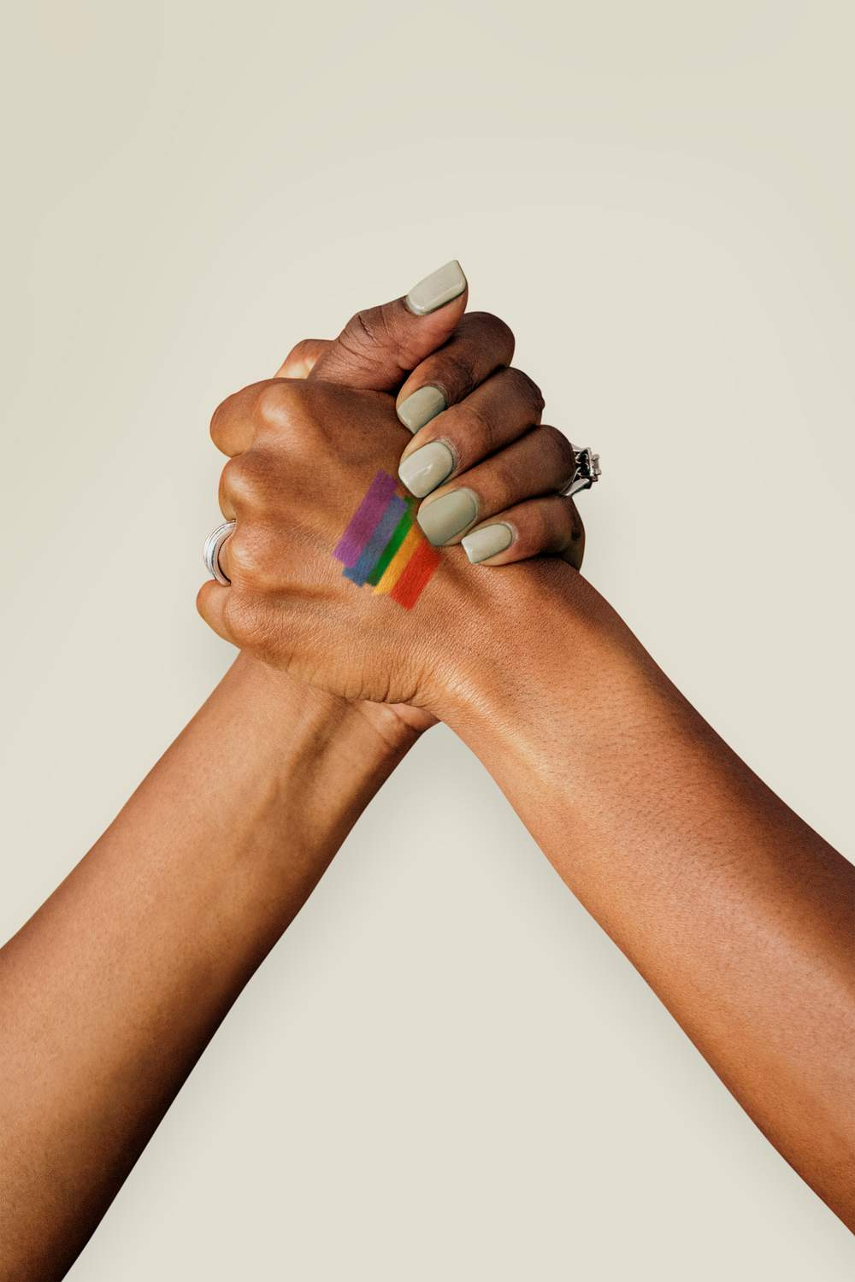



Trauma-informed care (noun) – An organizational structure and treatment framework that centers on understanding, recognizing, and responding to the effects of all types of trauma.
Tucking (noun) – The process of hiding one’s penis and testes with tape, tight shorts, or specially designed undergarments.
Two-Spirit (adjective) – Describes a person who embodies both a masculine and a feminine spirit. This is a culture-specific term used among some Native American, American Indian, and First Nations people.

Slide 21
Outdated term | Recommended term
Berdache | Two-spirit
Biological female/male | Assigned female/male at birth
Cross-sex hormone therapy; hormone replacement therapy | Gender-affirming hormone therapy
Disorders/differences of sex development | Intersex
Female-to-male (FTM) and Male-to-female (MTF) | Transgender man and transgender woman
Gender nonconforming | Gender non-binary
Hermaphrodite/Ambiguous genitalia | Intersex
Homosexual | Gay or lesbian
Legal name | Administrative name or Name on legal documents
Preferred name | Chosen name or Name used
Preferred pronouns | Pronouns
Sex change/Sex reassignment surgery/Gender reconstruction surgery | Gender-affirming surgery
Sexual preference/lifestyle | Sexual orientation
Transgendered | Transgender

Slide 22
Barriers to Care of LGBTQ+ Patients
Limited Access – LGBT+ people are less likely to have health insurance, either because they have been rejected by their families when they are young, or because they are unemployed or homeless, or because they require services that are not available to them even when they have health insurance.
Negative Experiences - They may experience discrimination or prejudice from health care staff when seeking health care, services, help... Bad experiences with inadequately-trained professionals are a big reason why LGBTQ+ people do not seek medical care; many also report that they look for clues when arriving at a health care facility, such as the way they are greeted by staff, whether non-discrimination policies are posted in public areas, or if there are single occupancy or gender-neutral bathrooms. There are so many bias in many scenarios (e.g. Dress Code – binary ones; language used in the classroom; disrespectful treatment…)
Lack of Knowledge – LGBTQ+ people sometimes discover that providers do not have knowledge or experience in caring for them. These barriers present a challenge for LGBTQ+ individuals and health care/services/academic staff throughout the nation. The good news is that overcoming them does not require extensive training or highly technical expertise.

Slide 23
Health Care Providers as Advocates
To be an advocate is part of our mission as a health care professional.
“Medical education does not exist to teach individuals how to make a living, but to empower them to protect the health of the public”.
Defining an advocate: a person who argues for or support a cause or policy, for their community, patient and a cause.
Therefore, a health care professional must understand the social determinants of health, know their community and its needs to guide the support and changes in the community.

Slide 24
HEALTH EQUITY (LET’S RENAME IT : HEALTH JUSTICE)
Health equity generally refers to individuals achieving their highest level of health through the elimination of disparities in health and health care.
Healthy People 2020: defines health equity as the attainment of the highest level of health for all people, and notes that it requires valuing everyone equally with focused and ongoing societal efforts to address avoidable inequalities, historical and contemporary injustices, and health and health care disparities.
CDC: defines the achievement of health equity as when every person has the opportunity to “attain his or her full health potential” and no one is “disadvantaged from achieving this potential because of social position or other socially determined circumstances.”

Slide 25
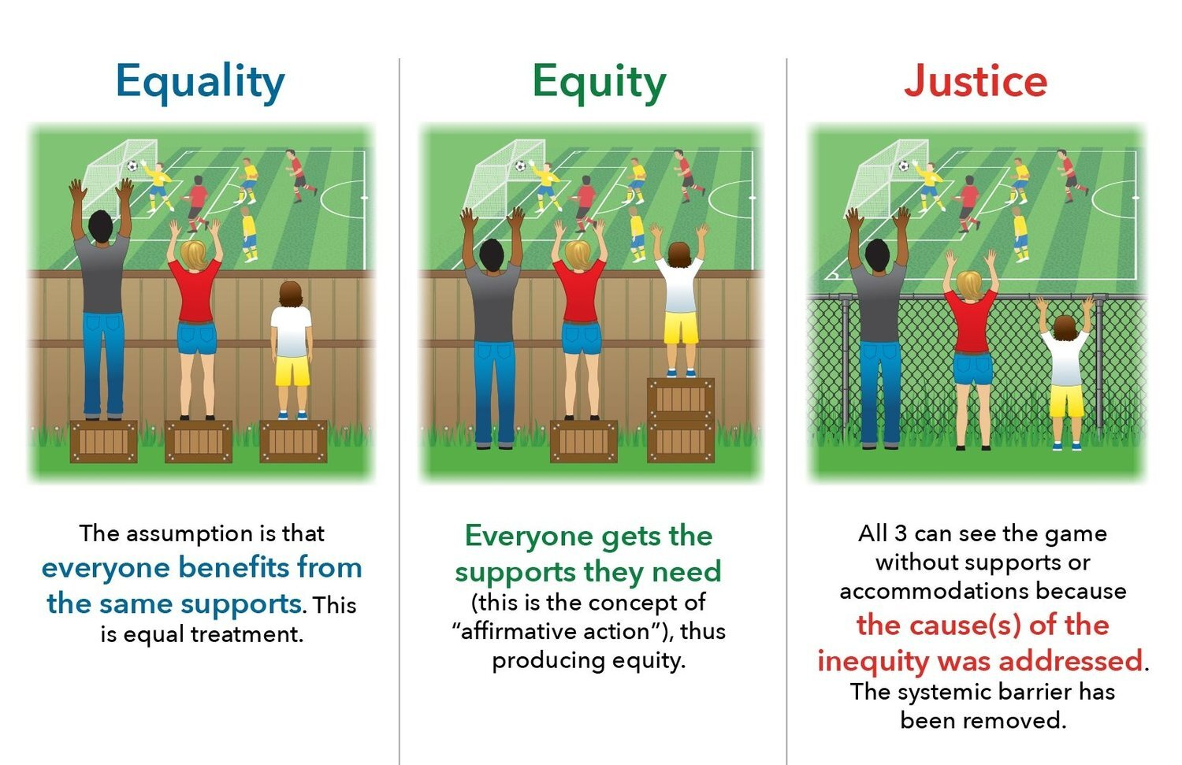
What are we looking for?

Slide 26
What can we do as health professionals to promote health JUSTICE?
Clinical activities:
Recognize, avoid and address bias (cultural, racial, sex, age)
Express compassion (do not blame the victims)
Screen for socioeconomic factors.
Coordinate with interdisciplinary teams
Refer patients to community resources.
Public Activities:
Advocate for pro-health policies.
Promote health system changes.
Work collectively with others outside the health system.
Address structural violence.
Vote

Slide 27
II. How Should I Ask? (LGBTQ+)
He, She, Her, His, It , They, Them (How do you identify yourself? How do you like to be call? What pronouns you use?)
Ask: Are there any special needs or concerns you have related to your health care that you would like me to know about?
Concerns: What questions or concerns do you have about ?
Genuine: Is there any way I can help to make you more comfortable while you are in my office?
Offer: Do you need to be referred to someone or something in special in order to feel more comfortable?
  Us: Do you have any beliefs or practices that would be important for us to consider regarding the options I just explained to you?

Slide 28
How Should I Ask?...
Objections: I’m understanding that you have certain objections and I respect that. Can you tell me a little more about your objection? I want to understand your concerns better?
Support: Would it be helpful to you to speak to anyone important for you (Personal Counselor, mentor, couple…) about what we’ve discussed?
  Management: How do you want to be called? Is there someone you want to join us while I auscultate you? Is there something I need to know, or you want to inform before the treatment/surgery/auscultation? I want you to feel comfortable and safe…

Slide 29
Other situations…
Do you need special access?
May I help you by referring your concern to someone?
How can I help you?
I’m your Health Care assistance. I’m here for you!

Slide 30
Key Findings
The Trevor Project’s 2023 U.S. National Survey on the Mental Health of LGBTQ Young People amplifies the experiences of more than 28,000 LGBTQ young people ages 13 to 24 across the United States. This survey gives a voice to LGBTQ young people — at a time when their existence is unfairly at the center of national political debates and state legislatures have introduced and implemented a record number of anti-LGBTQ policies.
For the fifth consecutive year, these data underscore that anti-LGBTQ victimization contributes to the higher rates of suicide risk reported by LGBTQ young people and that most who want mental health care are unable to get it.
Importantly, this research also points to ways we can all support the LGBTQ young people in our lives by highlighting protective factors like creating affirming spaces and respecting pronouns, as well as the topics about which LGBTQ young people wish those in their lives knew more.

Slide 31
41% of LGBTQ young people seriously considered attempting suicide in the past year — and young people who are transgender, nonbinary, and/or people of color reported higher rates than their peers.
Transgender and nonbinary young people who reported that all of the people they live with respect their pronouns reported lower rates of attempting suicide.
Roughly half of transgender and nonbinary young people found their school to be gender-affirming, and those who did reported lower rates of attempting suicide.
Nearly 1 in 3 LGBTQ young people said their mental health was poor most of the time or always due to anti-LGBTQ policies and legislation.

Slide 32
56% of LGBTQ young people who wanted mental health care in the past year were not able to get it.
Fewer than 40% of LGBTQ young people found their home to be LGBTQ-affirming.
A majority of LGBTQ young people reported being verbally harassed at school because people thought they were LGBTQ.
Nearly 2 in 3 LGBTQ young people said that hearing about potential state or local laws banning people from discussing LGBTQ people at school made their mental health a lot worse.

Slide 33
41% of LGBTQ young people seriously considered attempting suicide in the past year including half of transgender and nonbinary young people and nearly 3 in 10 cisgender young people.
14% of LGBTQ young people attempted suicide in the past year
including nearly 1 in 5 transgender and nonbinary young people and nearly 1 in 10 cisgender young people.
(2022)

Slide 35
What to do?
Be empathic and gentle
Respect the differences, embrace the similarities
Avoid face gestures and comments
Doubts? Ask!
Never assume!
Beware of Microagressions!

Slide 36
MICROAGRESSIONS AND CONSEQUENCES
Bad Clinical Scenario
- no teamwork
- poor interpersonal relationships
- low productivity
- fewer cases solved
More mental health problems
- low self-esteem
- bulling
Increase in Mortality
- lack of timely patient care
- suicides
Notes:
Lack of timely patient care - Falta de atención oportuna al paciente

Slide 37
The Problem?
If you don’t do nothing, you are part of the problem
If you don’t see anything, you are part of the problem
If you don’t work for justice, you are part of the problem
If you don’t work on the micros and macros…YOU ARE THE PROBLEM!

Slide 38
"How can I help you?"
Your patient has a “need”, to heal a condition.
(Physical/Mental/Emotional)
Orientation, Gender, Gender expression… is not the task. Respect is!

Slide 39
Ten Strategies for Creating Inclusive Health Care Environments for LGBTQIA+ People
Leadership actively engaged and informed
Organizational Policies protect LGBTQIA+ People
The physical and virtual environment welcomes LGBTQIA+ People
Forms reflect LGBTQIA+ People and their relationships
Partnerships with the LGBTQIA+ Community
All Staff receive training on affirming communication and care
Sexual orientation and gender identity data are collected and used to improve health outcomes
All patients receive routine and inclusive sexual health histories
Clinical care and services meet LGBTQIA+ health care needs
LGBTQIA+ people are recruited and retained

Slide 40
Ubuntu is a South African ethical rule focused on the loyalty of people and the relationships between them. The word comes from the Zulu and Xhosa languages. Ubuntu is seen as a traditional African concept.
There are several possible translations of the term into English, the common ones are:
"Humanity towards other people"
"If everyone wins, you win"
"We were because we are"
"A person becomes human through other people"
"I am what I am based on what all people are"
"Belief is a universal link of sharing that connects all humanity."
Modesty
Empathy
“I am because we are, and since we are, then I am.”
"The common good is one's own good."
“A person with Ubuntu is open and available to others, supports others, does not feel threatened when others are capable and good at something, because they are sure of themselves since they know that they belong to a great whole, that It decreases when other people are humiliated or belittled, when others are tortured or oppressed.” - Desmond Tutu

Slide 41


Slide 42

How to find me:
SOM DEIJ Office– Building “L” (787)840-2575, extension 4739
Mobile: (787)661-7258

Slide 43

Do Good. Be Well. Have Peace. Be Blessed.

Slide 44
Questions
Case : A 13-year-old girl of masculine appearance visits the doctor’s office. The doctor greets her by calling her "nice young lady" and begins taking her vitals. The young woman gets up from the stretcher very upset and tells her mother that she does not wish to continue the visit.
Which of the following should be the first step in the interview?
a. End the interview immediately.
b. Interview the mother first.
c. Ask her respectfully what she wants to be called.

Slide 45
Correct answer is:
c. Ask her respectfully what she wants to be called.
That is the respectful and considerate way every patient expects to be treated by their doctor.

Slide 46
“Mario” is brought to the office to be examined. His/her/it parents are very concerned because he/she/it has expressed that he/she/it has "coming out" and wants to start a process.
The first step should be:
a. Gender affirmation
b. Gender-affirming surgery (GAS)
c. Gender-affirming genital surgery

Slide 47
Correct answer is:
a. Gender affirmation (legal, psychological, social)
The patient needs to go through this transition with the help of their family, friends and, above all, their doctor. The clinical processes/operations/ hormone treatments... will come in due time and in a responsible manner.

